Slide 1
Computer Vision Fundamentals
Lecture 3 - Part 3
Point Processing

Slide 2
Contents
Transformation Schema
Operations
immultiply( ) function
Compliments

Slide 3
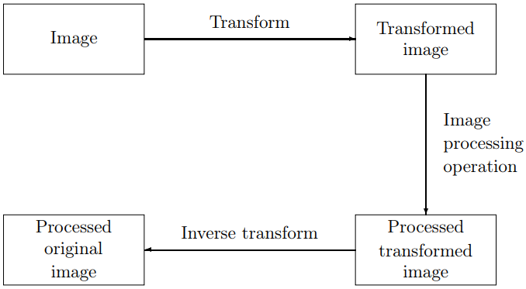
Transformation Schema
We require a knowledge of all the grey levels in the entire image to transform the image. In other words, the entire image is processed as a single large block.
Although point operations are the simplest, they contain some of the most powerful and widely used of all image processing operations. They are especially useful in image pre-processing, where an image is required to be modified before the main job is attempted

Slide 4
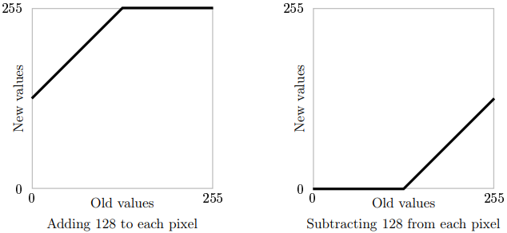
Operations
We can obtain an understanding of how these operations affect an image by looking at the graph of old grey values against new values. the Figure shows the result of Adding or subtracting 128 from each pixel in the image.
Notice that when we add 128, all grey values of 127 or greater will Old values New Values Adding 128 to each pixel . Old values new Values Subtracting 128 from each pixel Figure 5.2: Adding and subtracting a constant be mapped to 255. And when we subtract 128, all grey values of 128 or less will be mapped to 0. By looking at these graphs, we see that in general adding a constant will lighten an image, and subtracting a constant will darken it.

Slide 5
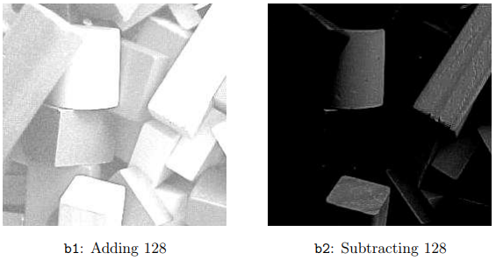
cont..
A more elegant way, is to use the Matlab function imadd which is designed precisely to do this:
>> b1=imadd(b,128);
Subtraction is similar; we can transform out matrix in and out of double, or use the imsubtract function:
>> b2=imsubtract(b,128);
And now we can view them:
>> imshow(b1),figure,imshow(b2)

Slide 6
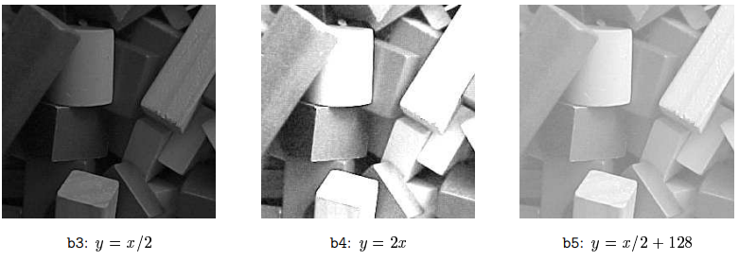
immultiply( ) Function
We can also perform lightening or darkening of an image by multiplication; figure shows some examples of functions which will have these effects. To implement these functions, we use the immultiply function.
>> b3=immultiply(b,0.5);
>> b4=immultiply(b,2);
>> b5=imadd(immultiply(b,0.5),128);

Slide 7
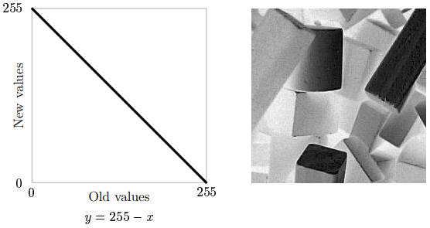
Compliments
The complement of a grayscale image is its photographic negative. If an image matrix m is of type double and so its grey values are in the range to, we can obtain its negative with the command
>> bc=imcomplement(b); >> imshow(bc)

Slide 8
Thankyou

